Slide 1
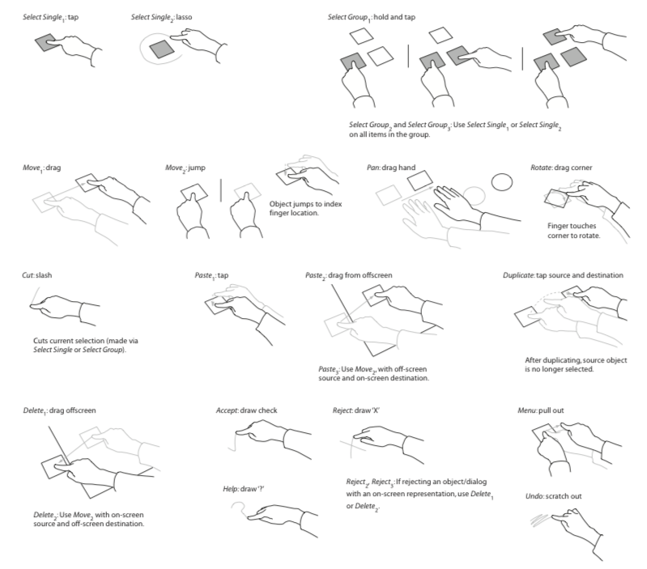
Gestural Interaction CSCI 3002 Fall 2018

Slide 2
Today
How gestures work
Designing gestures

Slide 3
Other class stuff
Quiz 2
In recitation tomorrow OR online
Online from 8am Friday to 12pm Sunday (MT)
Final assignments posted
Group 5 (user testing), 6 (finalizing prototype and making a storyboard), 7 (video and web site)
Solo assignments 3 and 4 (one page writeups)

Slide 4
Where we are
Part 3 of 3 in our exploration of user-centered interface design
What we’ve done so far
Understanding user interface conventions & foundations
Prototyping methods
User research methods
User performance testing
Now: exploring current trends and topics in HCI
gestures, graphics, audio, collaboration, ethics
Notes:
Not part of most textbooks. I think understanding this stuff is really important!

Slide 5
Gestures
What counts as a gesture?
Sensing gestures
Recognizing gestures
Evaluating gestures
Designing gestures
Teaching gestures

Slide 6
What is a gesture anyway?
Body movements
Communicating some action to the system
System or language of gestures

Slide 7
What is a gesture anyway?
Interaction involving some body movement – usually hands, but not necessarily
Often considered a discrete command: e.g., shake device to undo
May occur on a surface, in air, on body
May represent directional movements (1D), 2D or 3D shapes

Slide 8
Why this is important
Gestures are increasingly becoming a core part of our user interfaces
New input technologies lead to new gestures
Replacing explicit UI with gestures can negatively affect usability
(e.g. Norman and Nielsen, Gestural Interfaces: A Step Backward in Usability)

Slide 9
Discussion: good and bad gestures
Talk with your neighbor about good and bad gestural interfaces, and why they are good/bad

Slide 10
Good Bad
“Bloom gesture”
Intuitive
Pinch to zoom
Action directly corresponds to movement
Supports a metaphor
Feedback
Satisfying motion
Three finger swipe for desktop switching
Does what you think it would do
Feels faster
Directional swipe
Metaphor to physical world
Interactive art (Target pong)
New / novel
Fun
Embodied
“Bloom gesture”
Hard to get right
N-finger swipe
Why is it different?
Accidental activation
Don’t even know what you did
Sometimes can’t activate
Directional swipes
Arbitrary
Minority Report (contested)
Melodramatic
Not clear what to do with it

Slide 11
Sensing gestures
How we sense gestures reflects what gestures are possible
Common gesture input methods
Touch screen
Mouse/touchpad
2D camera
Depth camera
Accelerometer/gyroscope
Pen gestures

Slide 12
Touch screens
Two main sensing technologies: resistive and capacitive
Resistive: activated when user presses layers together
Requires force to activate
Typically averages multiple contacts to center point
Examples: airplane screens, Nintendo DS
Capacitive: activated when contact made with human skin (or other electrically conductive object)
Requires electrically conductive contact
Can support gestures, multiple touches
Examples: most smartphones and tablets

Slide 13
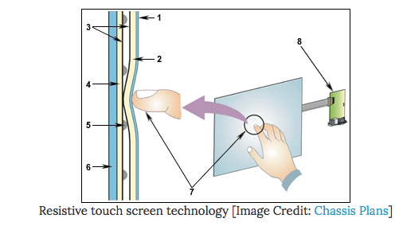
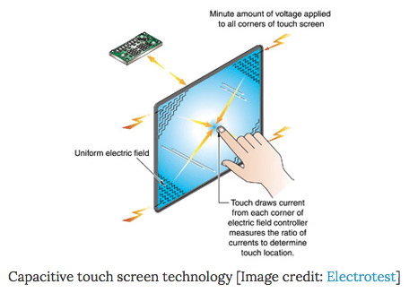
Notes:
Examples from scienceline: http://scienceline.org/2012/01/okay-but-how-do-touch-screens-actually-work/
Resistive touch screen image: http://www.chassis-plans.com/white_paper_resistive_touchscreen_technology.html
Capacitive touch screen image: http://www.electrotest.com.sg/cap_touch.htm

Slide 14
Touch screen gestures
Can typically measure:
Movement, direction, speed, number of contacts
Cannot measure (in most cases):
Pressure*, which fingers are being used, orientation of hand, interactions off the surface
* This is changing somewhat with Apple’s Force Touch; can sometimes be approximated using touch contact size

Slide 15
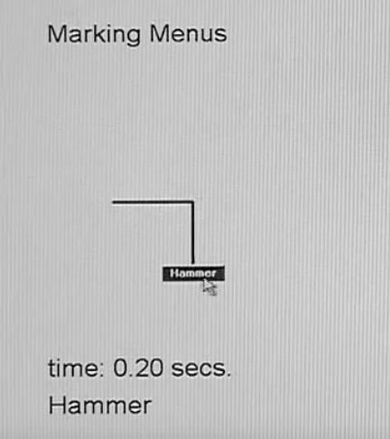
Mouse/touchpad
Typically requires some mode switch to distinguish gestures from regular cursor movement (segmentation)
Often involves “indirect” gestures – general movement rather than gesturing on a specific on-screen object
Can be useful for expert use; e.g. marking menus

Slide 16
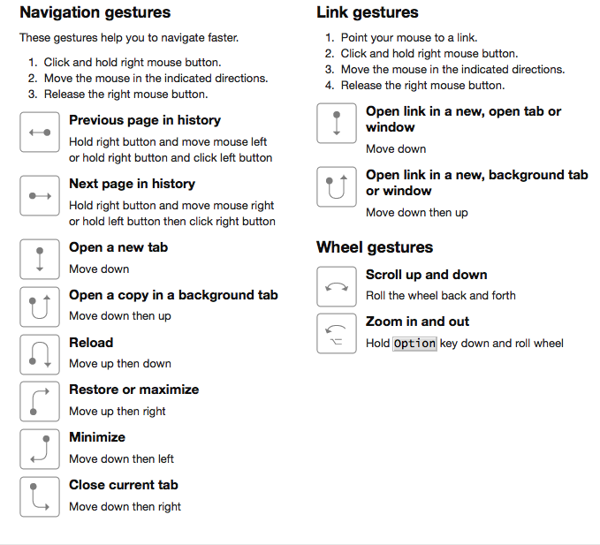
Opera mouse gestures

Slide 17
2D cameras
Mostly used in research prototypes; hasn’t taken off in commercial devices
Can track hands and other objects using computer vision
Requires marking hands or performing (sometimes noisy) image segmentation
Difficult to determine surface contact
Kane et al., Bonfire

Slide 18
Depth cameras (3D)
Examples: Microsoft Kinect, Intel RealSense, LeapMotion
Tracks 3D movement
Can sometimes infer body parts
Cons: may be less precise, not very portable, 3D gestures are difficult to perform
Microsoft Kinect
Notes:
Side note: interesting that these technologies often filter down to research/experimentation
PrimeSense camera $10,000 -> Kinect $200
Kinect image: https://upload.wikimedia.org/wikipedia/commons/3/3d/Kinect_Skeleton_View.jpg

Slide 19
Accelerometer/gyroscope
Use motion of device itself as gesture input
Accelerometer: detect acceleration along device x,y,z axes
Can infer orientation (by detecting gravity)
Can detect thumps / whacks / collisions
Often requires big movements due to gravity, noise
Theoretically, can integrate acceleration to track velocity/position, in practice you can’t
Gyroscope: can detect device orientation and angular movement

Slide 20
Case study: Wiimote
Uses accelerometer to detect gestural movements
Later augmented by MotionPlus (w/ gyroscope)
Not accurate enough for pointing, supplemented by infrared pointing input via sensor bar
Notes:
Interesting how wii sensor bar works: it’s actually just 2 infrared lights, Wiimote has camera
Wiimote image: https://www.wikihow.com/images/3/3a/Pitch-Under-Hand-in-Wii-Sports-Step-3-Version-2.jpg
Wii menu: https://cdn02.nintendo-europe.com/media/images/06_screenshots/systems_4/wii_10/wii_channels/wii_menu/CI-Wii-Wii-Menu-02-UK_CMM_small.jpg

Slide 21
Pen/stylus gestures
Can augment pen with sensors to detect position, orientation, etc.
Can add buttons on pen barrel
Easy to detect contact on surface
Can sometimes detect “hover” state
Microsoft
Surface Pen
Notes:
Microsoft Surface Pen: http://cnpichub1.freepicturehub.com/Microsoft/6.jpg

Slide 22
Hover Widgets (Grossman et al. CHI ‘06)
Use hover state of a stylus to access nearby targets
Demo video

Slide 23
Other sensing methods
Device sensors: camera, ambient light sensor, face tracker, eye tracker
Body sensing: EEG, EMG
Research opportunities to use new sensors in interesting ways
Saponas et al., Muscle-Controlled User Interfaces

Slide 24
Recognizing gestures

Slide 25
Recognizing gestures
It’s worth knowing how gestures are typically recognized
Helps us determine what gesture sets are good or bad
Typical methods
Heuristic methods
Shape-based recognition
Machine learning-based methods

Slide 26
Heuristic gesture recognizers
Can wire up gesture recognizer using existing UI events
// swipe detector
function onTouchDown(float x, float y) {
// save where we touched down
Point startPoint = new Point(x,y);
}
function onTouchUp(float x, float y) {
// where did we touch up?
Point endPoint = new Point(x,y);
// measure the difference
diffX, diffY = endPoint – startPoint;
// we have a heuristic for what constitutes a swipe
if (diffX < -30 && -10 < diffY < 10)
handleSwipeLeft();
}

Slide 27
Limitations of heuristic approach
Hard coded values may not represent what users actually do
No capability to adapt behavior to user or context
Clunky, but often our best option

Slide 28
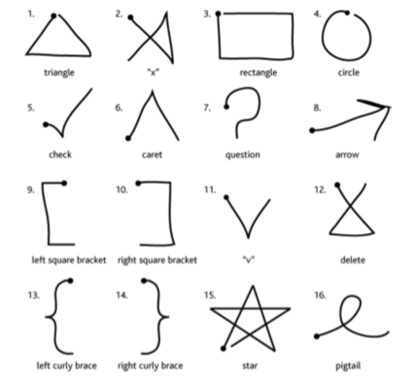
Shape-based recognition
Compare shape of gesture to set of reference gestures
Common algorithms: Dynamic time warping, Rubine (1991), $1 recognizer
Limitations: can be confused by direction of movement, multi-stroke gestures
Wobbrock et al., $1 recognizer

Slide 29
$1 Gesture Recognizer
Recognizer designed to be simple to implement, with decent performance
Limited to unistroke gestures (although this is addressed in alternative versions)
http://depts.washington.edu/madlab/proj/dollar/

Slide 30
Machine learning approaches
Various algorithms: neural networks, SVMs, AdaBoost
Can be more robust to individual differences, can be trained by example
But, models are sometimes opaque, must choose appropriate features, more trial and error
Good starting point: Fiebrink et al., Wekinator
See also: courses from Ben Shapiro and Chenhao Tan on ML for HCI

Slide 31
Recognition challenges
Segmentation: how do we know when a gesture begins or ends?
Assumptions of training data set
Size, speed, orientation, etc.
Does training data reflect all valid ways to perform the gesture?
Notes:
Approaches to segmentation: starting movement, out of band action, keypress

Slide 32
Evaluating gestures

Slide 33
Evaluating gestures
How should we evaluate whether a gesture is good or bad?

Slide 34
Evaluation criteria
Sufficiently distinct from each other (to person or system)
Not embarrassing / socially appropriate
Consistent use across system (multiple systems)
Good mapping to existing actions
Magnitude of gesture should map to magnitude of result
Physical exertion / ergonomics
Sensitive to context of use

Slide 35
Evaluation criteria
Recognition accuracy
Ergonomics / reachability
Intuitiveness / learnability
Social acceptability

Slide 36
Recognition accuracy
Types of errors: false positive, false negative, matched to other gesture
Costs/effects differ by error
Users will expect high accuracy: 95-99%
Identify commonly confused gestures and change them (or change recognizer)
Notes:
Each type of error has different implications

Slide 37
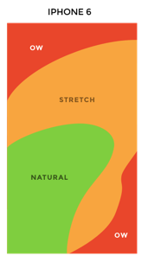
Ergonomics
Consider reach, physical effort, repetitive movements
“Gorilla arm” — humans are very bad at holding arms out for extended periods
Minority Report →
bad for gorilla arm!
Notes:
iPhone image: https://www.gizmodo.com.au/2014/09/how-to-design-for-thumbs-in-the-era-of-huge-screens/
Minority report image: https://static.independent.co.uk/s3fs-public/thumbnails/image/2013/02/11/11/Kinect-Minority-Report-UI-2.jpg

Slide 38
Considering contextual and physical limitations
Users can be constrained by their abilities or context
Free hands?
Holding something?
Sitting/standing/walking?
Example: Google Maps supports two finger pinch to zoom, also double tap + slide up/down
Notes:
Google Maps image: https://developers.google.com/maps/documentation/ios-sdk/images/url_scheme_pizza.png

Slide 39
Intuitiveness
How could we measure intuitiveness of a gesture?

Slide 40
What is intuitiveness anyway?
Understandable
Feedback (recall Norman)
Predictable outcome
Can be explained concisely, “makes sense”
Using what you know / no need for specialized knowledge

Slide 41
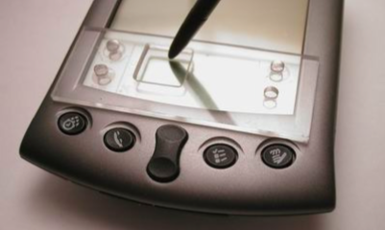
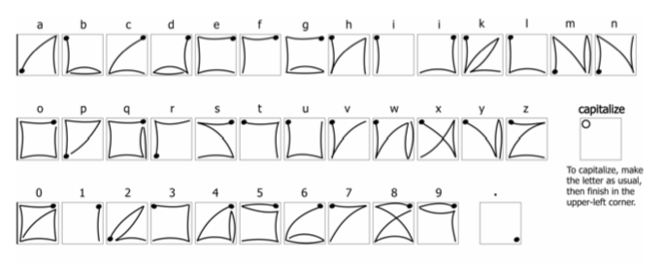
Testing intuitiveness
Learnability: how long does it take someone to learn?
Memorability: do users remember gestures after some time away?
Guessability: tell user what the goal is, ask them to guess what the gesture will be
Wobbrock et al., EdgeWrite

Slide 42
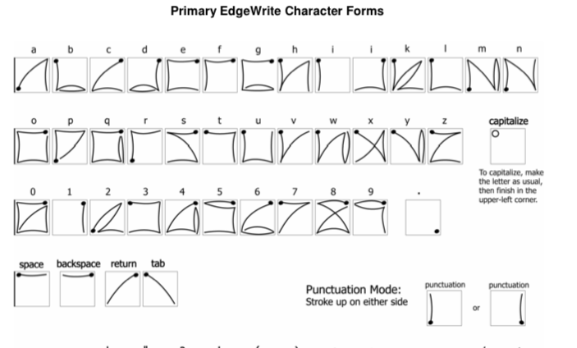

Slide 43
Are obscure gestures useful?
Not a great idea to hide dangerous features behind gestures
May activate by accident
Unclear what gesture does
May be some social benefit in learning obscure gestures
“Why Snapchat’s Design is Deliberately Confusing”
Notes:
To keep out the olds, but also to support social learning

Slide 44
Social acceptability
Some gestures may be intuitive, memorable, highly recognizable, and embarrassing
Must consider (and test) whether users are willing to perform gestures
Consider type of movement, location on body, etc.
May vary based on context and cultural factors

Slide 45
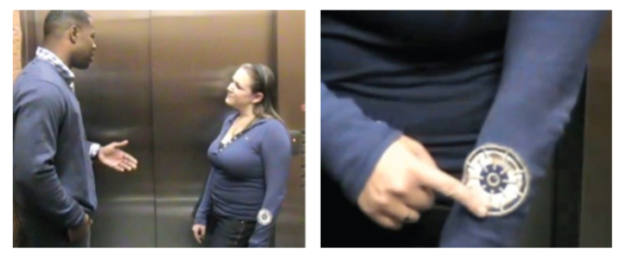
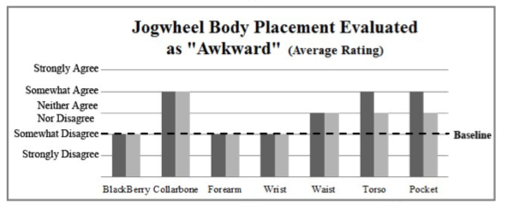
Profita et al., Don’t mind me touching my wrist

Slide 46
Designing gestures
Approaches for designing gestures
Handling complexity
Having a system of gestures
Determining what’s important

Slide 47
Approaches to designing gestures
Developing conventions
Using physical metaphors
User-defined elicitation methods
Dealing with complexity

Slide 48
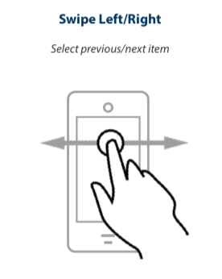
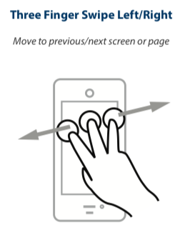
Developing conventions
This is an issue of mappings
How do characteristics of gesture (direction, shape, number of fingers) map to effect?
Users may have difficulty remembering complex mappings
Notes:
iOS voiceover gestures: https://www.interactiveaccessibility.com/education/training/downloads/iOS-Cheatsheet.pdf
Left to right: forward or back
Number of fingers: granularity. More fingers == bigger items

Slide 49
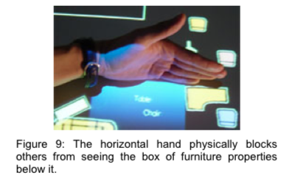
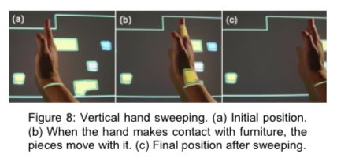
Using metaphors
Gestures can map to metaphors
At a basic level, direct manipulation of items on screen
Drag left, item goes left
Developing vocabulary of gestures can help in adoption
Wu and Balakrishnan, Multi-Finger and Whole Hand Gestural Interaction Techniques for Multi-User Tabletop Displays
Notes:
Figures from Wu and Balakrishnan, http://www.dgp.toronto.edu/research/tabletop/mwu_UIST2003.pdf

Slide 50
Gesture elicitation (Wobbrock et al., 2009)
Big idea: allowing users to pick their own gestures will lead to more intuitive gestures
But, users may pick gestures that conflict, or are difficult to memorize
Solution: elicit gestures from a set of representative users, maximize agreement
This method has become extremely popular and has been used for many types of gestures: mobile devices, body gestures, drone interactions…

Slide 51
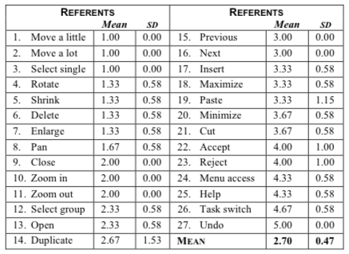
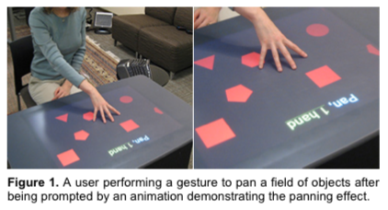
Eliciting gestures
Show participants outcome of action; allow them to demonstrate a gesture for that action
Pick gestures with largest # of agreeing participants

Slide 52
Dealing with complexity
Gestures have many variables
Example: for one-handed touch screen gestures, speed, size, number of figures, direction, location
It’s important to be clear about which variables change how the gesture is interpreted, and which don’t
Users may feel more strongly about certain variables
e.g., users do not feel strongly about the number of fingers in a gesture (Wobbrock et al., 2009)

Slide 53
Teaching gestures

Slide 54
How to teach gestures effectively?
Show, don’t tell
Provide feedforward and feedback
Hint at possible gestures

Slide 55
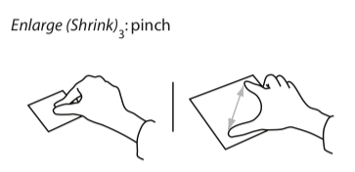
Show, don’t tell
“To zoom, pinch your fingers” vs. vs.
Notes:
Many aspects of the gesture are not clear: speed, movement, where do you start?

Slide 56
Feedforward and feedback
Feedforward?
Notes:
What are these?

Slide 57
Feedforward and feedback
Feedback: make it clear what I did
Feedforward: show possible actions from here
One (complex) example: Octopocus by Bau et al. (paper, video)

Slide 58
Hinting at possible gestures
Show that there is more content offscreen
Or show which objects can move
A simple form of feedforward
Notes:
The Windows example is aggressively cut off, signals “there is more here”
iOS button bounces the screen a little bit
Windows Metro: http://www.gadgethelpline.com/wp-content/uploads/2011/06/windows-phone-7-metro-490x343-1.jpg
iOS: http://tapsmart.wpengine.netdna-cdn.com/wp-content/uploads/2016/08/open-from-lock-screen-header-750x400.jpg

Slide 59
Gesture miscellany
Documenting gestures
User tests with gestures
Gesture accessibility
Downsides of gestures

Slide 60
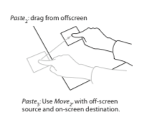
Documenting gestures
Video may be ideal: shows all aspects of how to perform gesture correctly
For figures, it’s often easiest to take a photo and then trace it
Use arrows to show motion

Slide 61
User testing gestures
Provide an introduction to the gesture set, then take away hints and documentation
Users will not have documentation in most cases
Test recognizer for accuracy, errors, confusion
Test gesture set usability by learnability, memorability, types of errors
Think aloud can help here

Slide 62
Gesture accessibility
Many users may have difficulty performing certain gestures (due to reach, hand pose, tremor, ability to touch and lift-off)
Many gestures rely on vision (to position on screen, to precisely control shape)

Slide 63
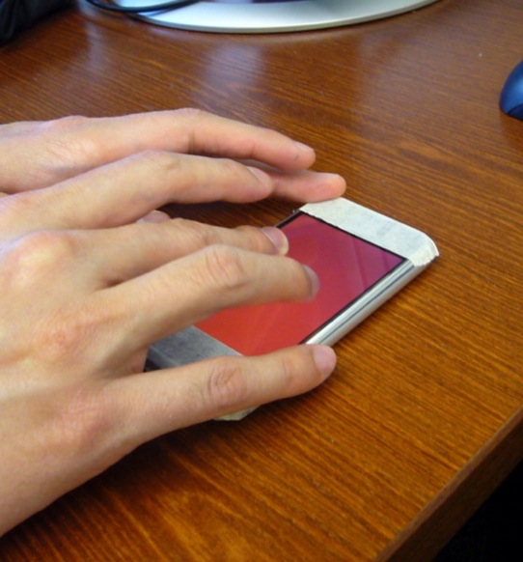
Eyes-Free Touch Screens
How can we design touch screen user interfaces that can be operated without sight?
Can we achieve this with off-the-shelf devices?
SK’s publications:
ASSETS 2008, 2009, 2014
CHI 2011🏆, 2013, 2016
DIS 2017
TACCESS 2015
Notes:
The first project is called Slide Rule. It began with the question: how can we take an existing touch screen based mobile device, which is not accessible, and redesign the fundamental interactions that it supports
And to give you some context about this project, although we did see accessibility on the iPhone in the video. This project, Slide Rule, predates that work. At the time this work began, most commercially available touch screen devices provided no accessibility support, and those that did were quite limited.

Slide 64
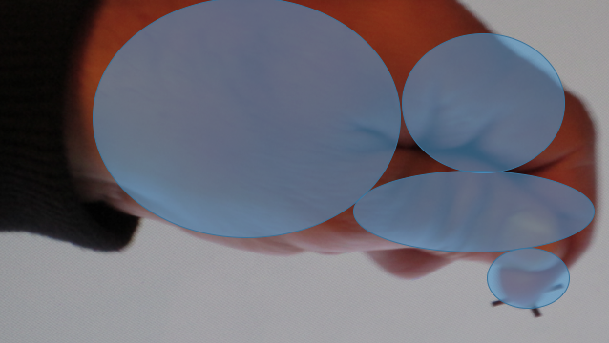
Hardware and software for diverse motor input
How to support upper limb input from people with a wide range of abilities
May require changes to both hardware and software
SK’s publications:
ASSETS 2007, 2009, 2014
CHI 2014🥈, 2016🏆
MobileHCI 2008🏆
TACCESS 2017

Slide 65
Gesture accessibility: what to do
Keep in mind that some users may be unable to perform some gestures, even standard gestures
Provide alternatives for keyboard, mouse, etc.
For blind and vision impaired users: Support system-wide accessibility systems (e.g. VoiceOver on iOS, Talkback on Android)

Slide 66
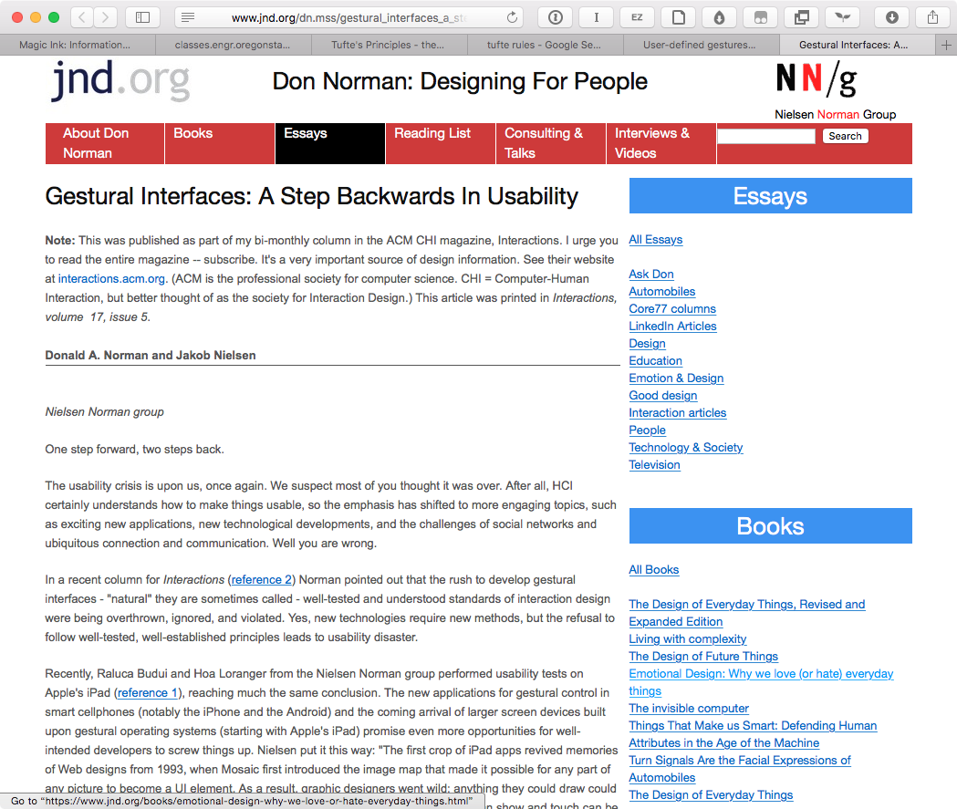
Downsides of gestures
Very low discoverability
Unclear what gesture requirements are
No standard gesture set
Norman and Nielsen, Gestural Interfaces: A Step Backwards In Usability

Slide 67
For Thursday
We will design gesture-based user interfaces 🎉

